Slide 1
Azure SQL Database
Level-200 Demonstration Companion Slides

Slide 2
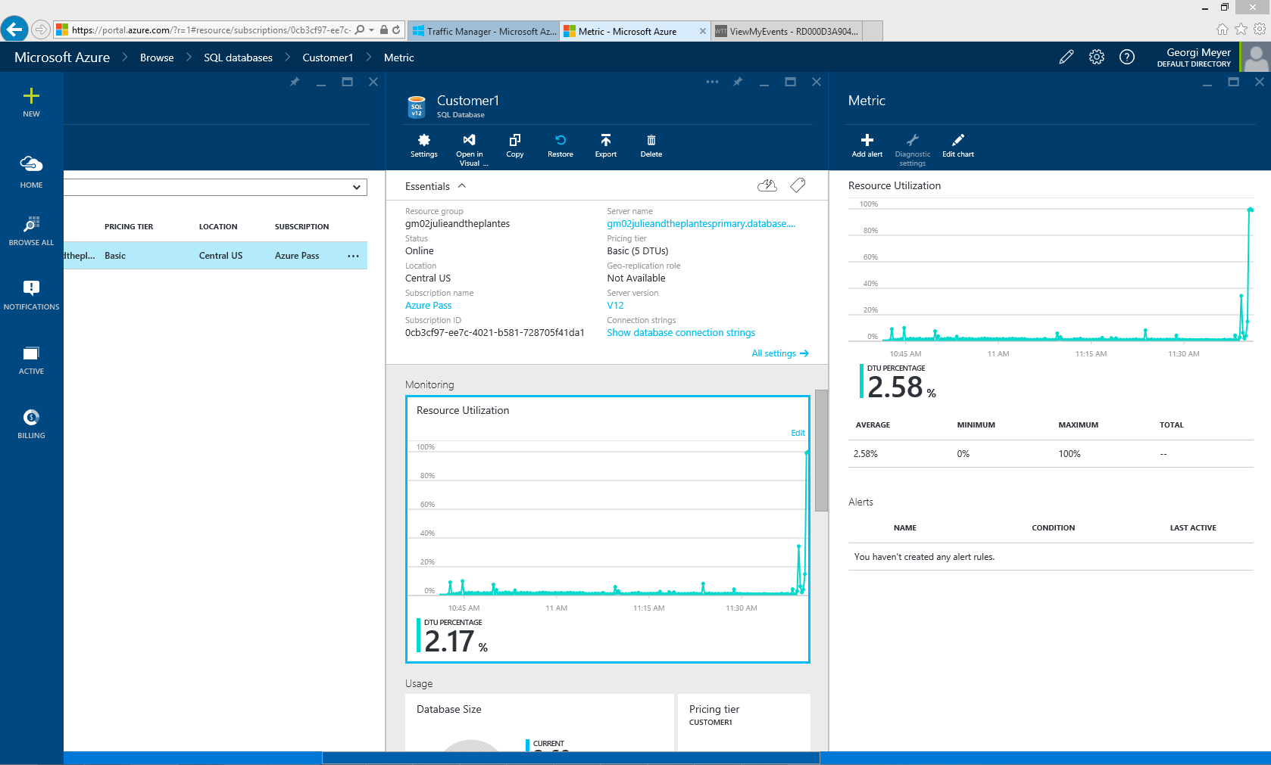
Demo Section 1: Vertical Scaling
The Customer1 database set at the Basic pricing tier displays a high utilization spike in the Resource Utilization chart.

Slide 3
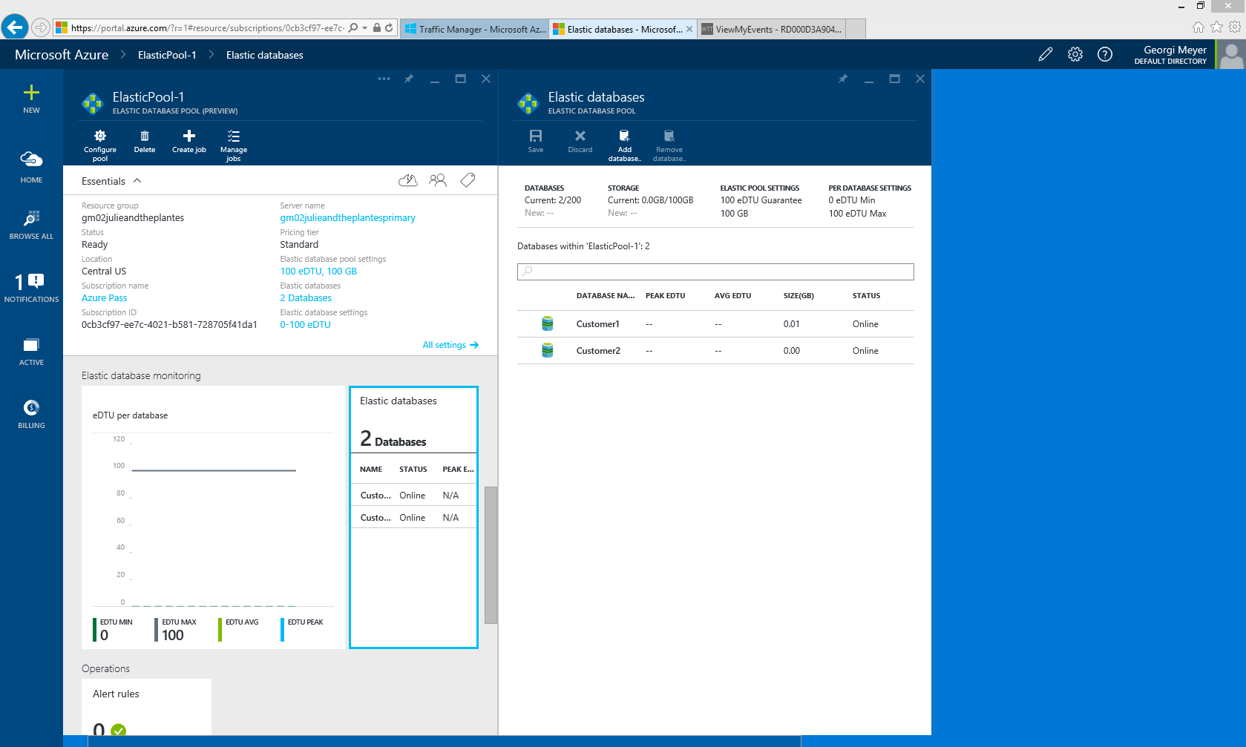
Demo Section 2: Azure SQL Database Elastic Database Pools
Here we see the Azure SQL Database Elastic Database Pool configured with Customer1 and Customer2 databases

Slide 4
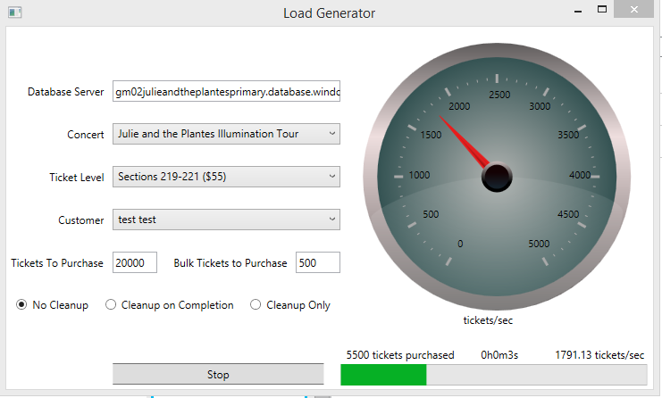
Demo Section 2: Azure SQL Database Elastic Database Pools
Run a ticket purchasing load against the Elastic Database Pool.
Simulates purchases 20000 tickets at a rate of 500 tickets at a time.
Notes:
What happens when we really hammer our servers and crank up demand to 20,000 ticket orders and 500 bulk order? That’s a total increase in demand of over 6x, so even our upgraded server from the last example won’t be able to cope—that’s several thousands of tickets purchased per second. Instead, we will look to see the load on our servers as part of an elastic database pool.

Slide 5
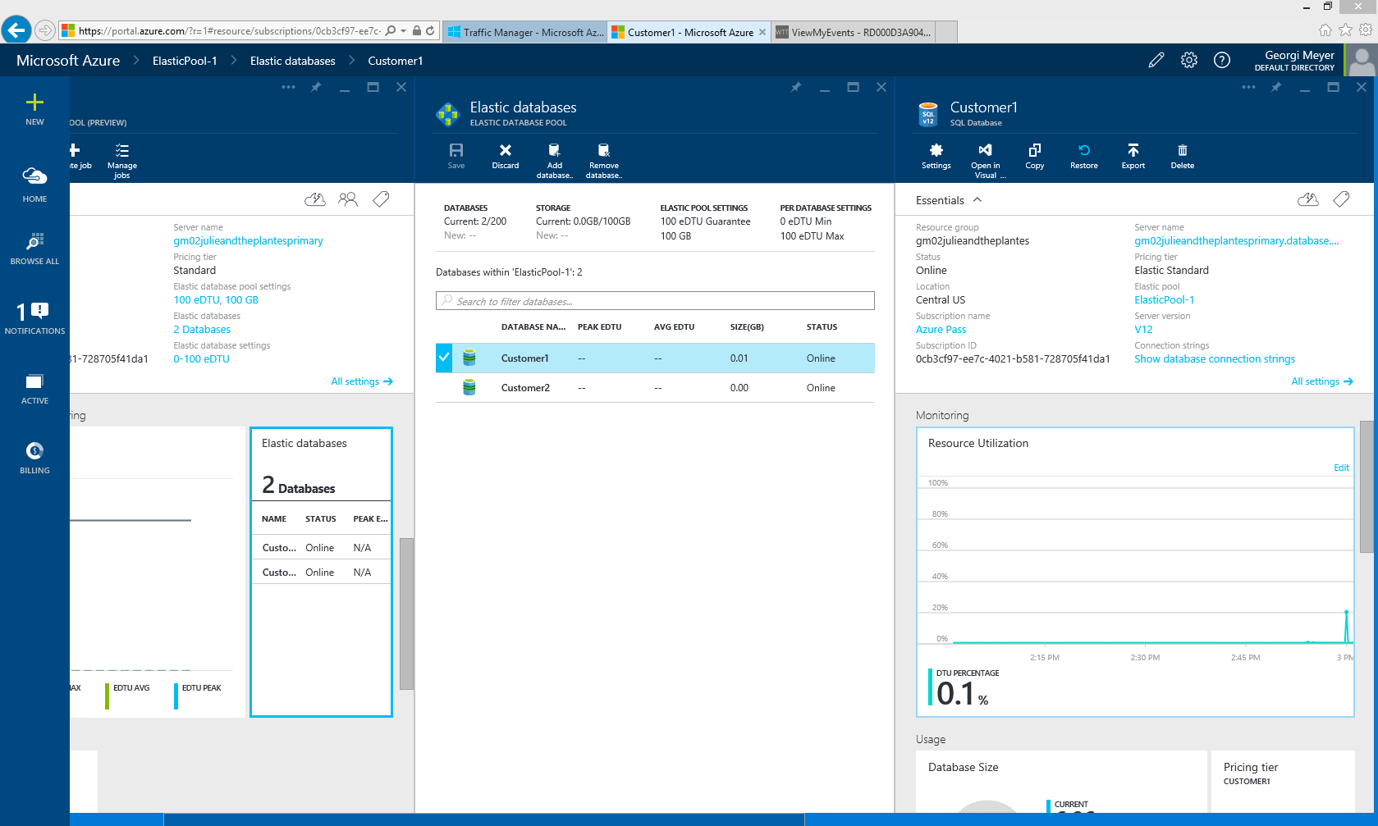
Demo Section 2: Azure SQL Database Elastic Database Pools
Selecting the Customer1 database in the Elastic Pool shows that the Resource Utilization from the bulk ticket purchase did not cause too much of a load on the database server.
Notes:
Look at the Customer1 database. Notice in the Resource Utilization graph that the max utilization was about 20 percent, yet the number of tickets per second increased over six times.
(Note: This value will likely vary depending on the values you specified in the load generator and the network from which you ran the test.)

